Slide 1
Design and layout of Full adder circuit with transmission gate

Slide 2
Objective
Design a 1-bit full adder in Cadence Virtuoso.
Simulate and verify the circuit.
Create a circuit layout of the given circuit and give the test input to verify result.

Slide 3
Introduction
1 bit full adder architecture consists of XOR gate for sum and for carry “AND” and “OR”. Those gate logic are replaced by CMOS logic such as Transmission gate logic and CMOS inverter. In summary, the full adder circuit combines two binary numbers along with a carry input to produce the sum of the numbers along with a carry output, making it a crucial building block in digital arithmetic circuits.

Slide 4
Application
-ALUs (Arithmetic logic unit) of CPU
-Program Counter
-Graphical processing unit

Slide 5
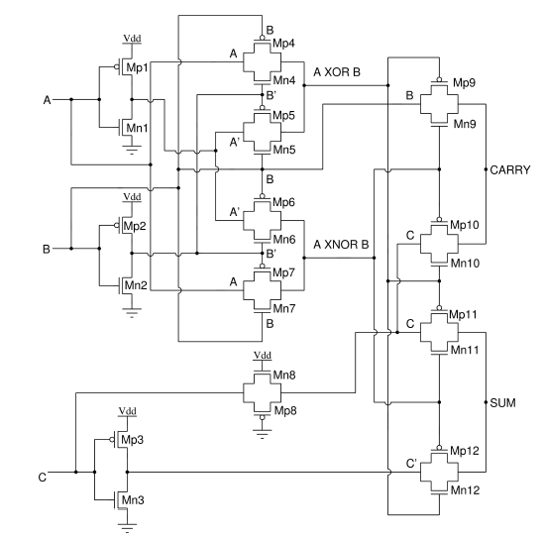
circuit
Fig 1- Circuit

Slide 6
Sizing of Transistor-
Circuit-2 Sizing with Umc 65 nm Technology :Reference Size:
PMOS width = NMOS width = 155nm, Gate length = 70 nm
Inverters:
PMOS (Mp1, Mp2, Mp3) sized as multiples of reference NMOS (Mn1):
Mp1: 2x reference size (PMOS double the size of NMOS)
Mp2: 8x reference size
Mp3: 4x reference size
Transmission Gates:
Standard: Mp4-7, Mp10-12, Mn4-7, Mn10-12 use reference size.
Delay-adjusted:
Mp8/Mn8: reference width, but 2x gate length (match C & C̅ delays).
Mp9/Mn9: reference width, but 3x gate length (match B & C to carry output)

Slide 7
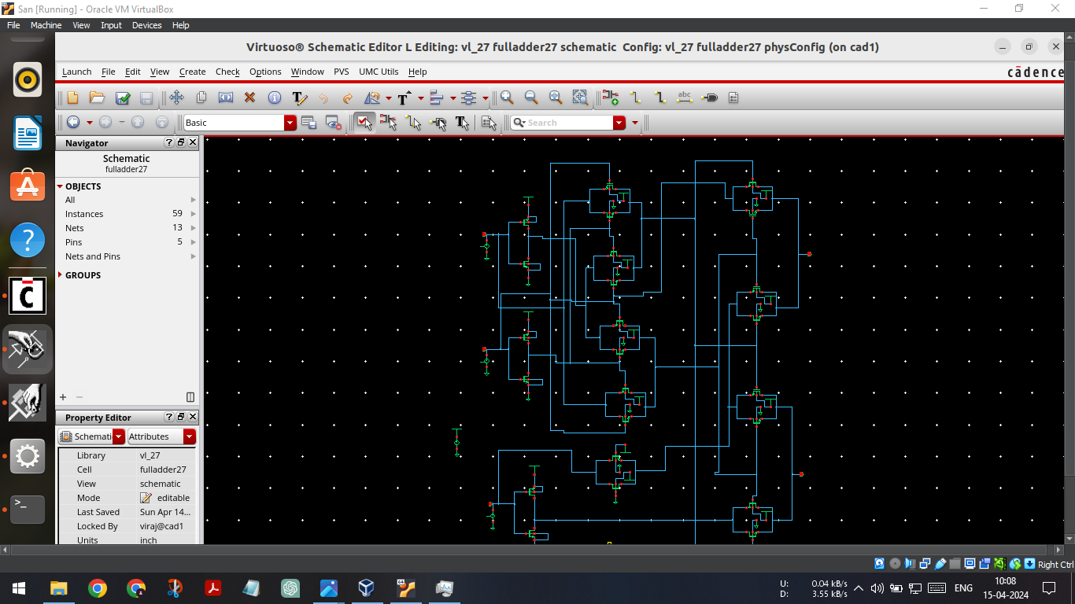
Schematic of proposed circuit-
Fig 2 - circuit

Slide 8
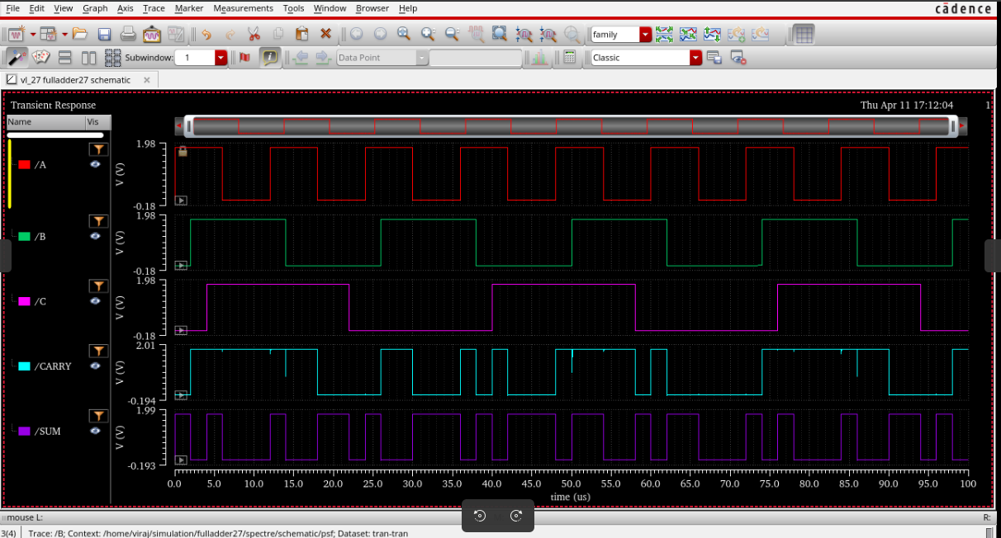
Result-
Fig 2 - Waveforms

Slide 9
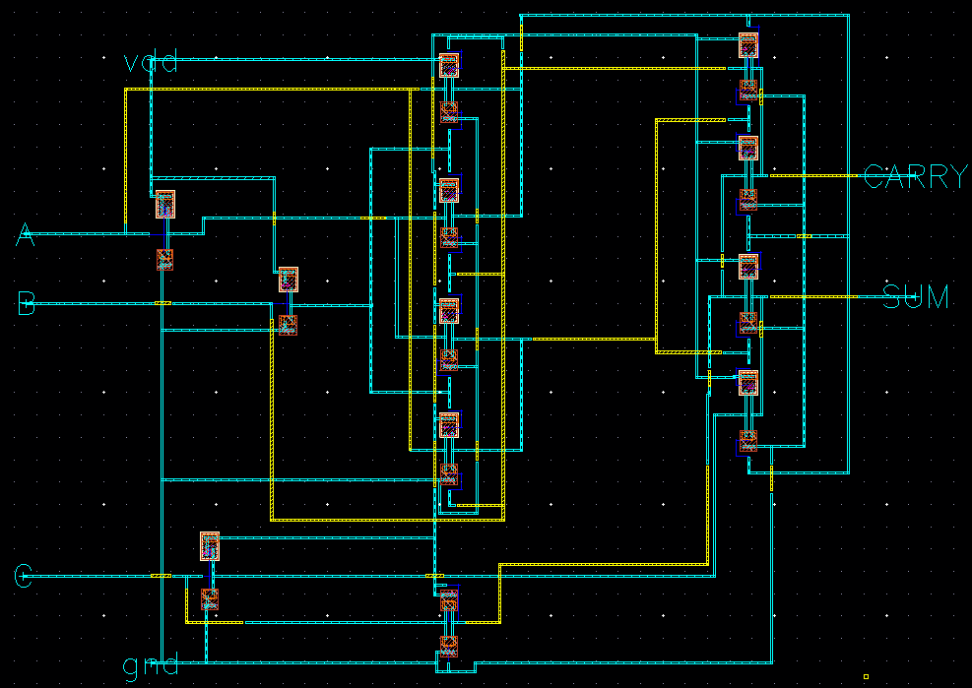
Layout-
Fig 2 - Layout

Slide 10
Schematic simulation result-
Delay
Sum- 69.17ps
Carry- 74.1 ps
Power- 10 .28 nW

Slide 11
Conclusion
It demonstrates better speed while also consuming less power and offering an improved PDP on simulation done in Ltspice.
Consequently, this architecture is well-suited for high-speed applications that prioritize power efficiency.

Slide 12
Reference
[1] Chiou-Kou Tung, Shao-Hui Shieh, Yu-Cherng Hung, and Ming-Chien Tsai (2006) High-Performance Low-Power Full-Swing Full Adder Cores with Out-put Driving Capability, 2006 IEEE Asia Pacic Conference on Circuits and Systems.(APCCAS-2006)
[2] Anantha P. Chandrakasan and Jan M. Rabaey (2016) Digital Integrated Circuits:A Design Perspective, Pearson Education India.

